Slide 1
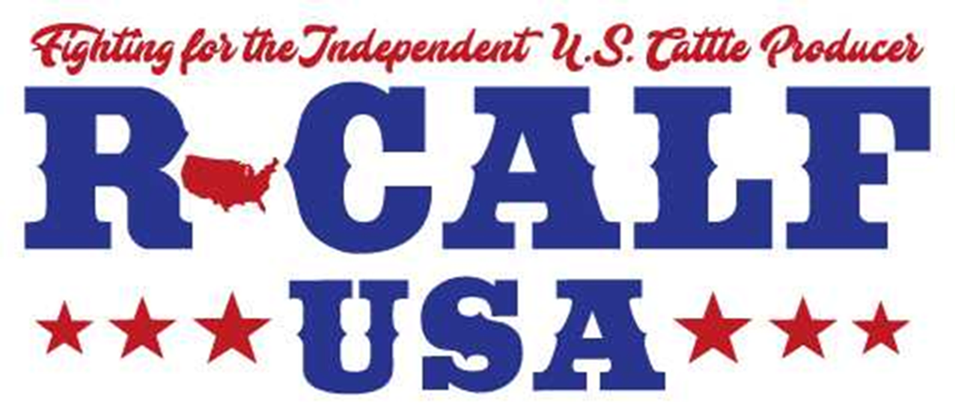
Why America Is Losing Its Ranches
Iowa State University
Addressing Issues in Animal Agriculture
Bill Bullard, CEO
March 8, 2022

Slide 2
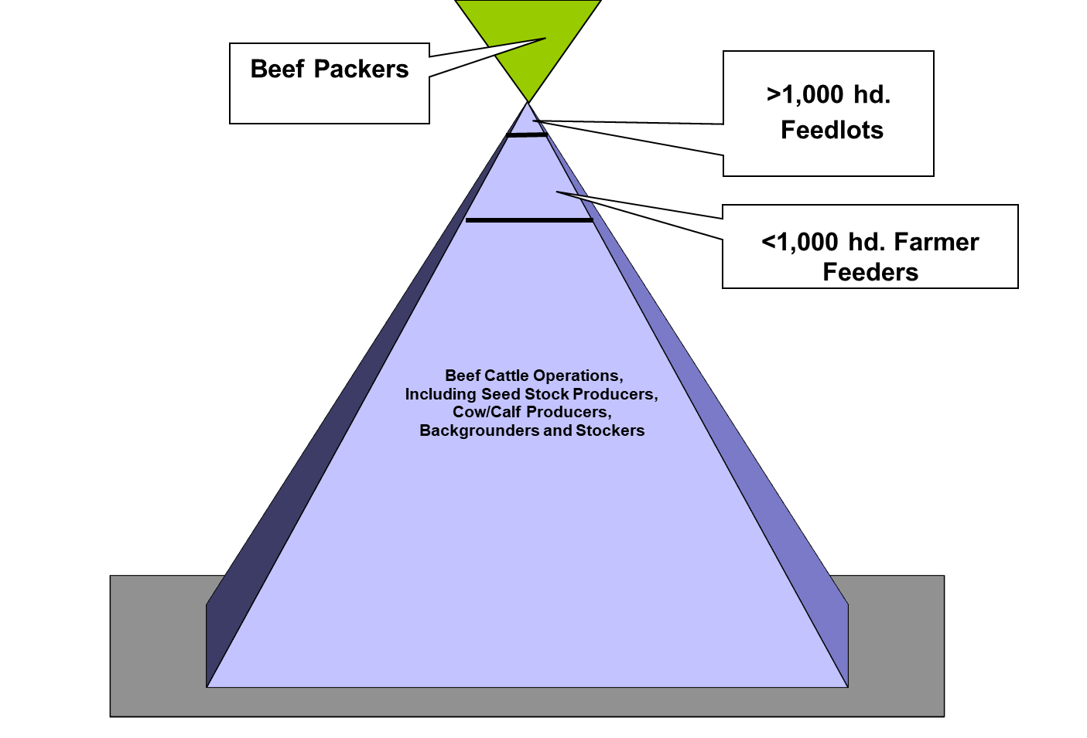

Slide 3
U.S. Cattle Industry’s Critical Competitive Infrastructure
Beef Cattle Farms & Ranches
Mother Beef Cows
Intermediary Marketing Outlets (Auction Yards & Feedlots)
Beef Packing Plants
Competitive Cattle Markets

Slide 4
Four Decades Ago, in America:
1.3 mil. Beef Cow Farms/Ranches
Over 37 mil. Beef Mother Cows
Over 113K Feedlots
1,477 Fed. Insp. Plants Slaughtered 32 mil. Cattle
Big 4 Packers Controlled 36% of Fed Cattle Slaughter

Slide 5
In 1994, When America Entered NAFTA:
Fewer than 907K Beef Cow Farms/Ranches
Fewer than 35 mil. Beef Mother Cows
Had 112K Feedlots (1996 data)
Only 882 Remaining Fed. Insp. Plants Slaughtered 33.5 mil. Cattle
Big 4 Packers Controlled 81% of Fed Cattle Slaughter

Slide 6
Today, Just Over a Generation Later, America has:
Eliminated 544K Beef Cow Farms/Ranches (43% Loss), With Only 729K Remaining.
Eliminated Nearly 7 mil. Beef Mother Cows, With Only 30 mil. Remaining.
Eliminated 75% of All Feedlots (85K Loss Since 1996), With Only 27K Feedlots Remaining.
Eliminated 54% of All Fed. Insp. Plants (Loss of 794 Plants), With Only 683 Remaining that Slaughtered 32.2 mil. Cattle.
Big 4 Packers Control 85% of Fed Cattle Slaughter.

Slide 7
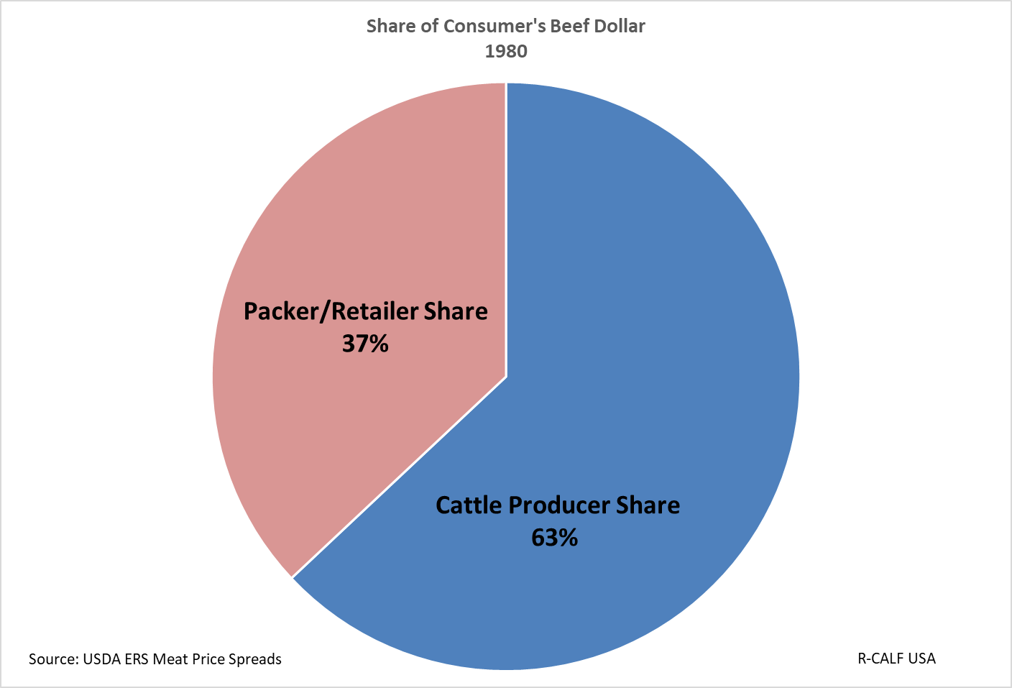
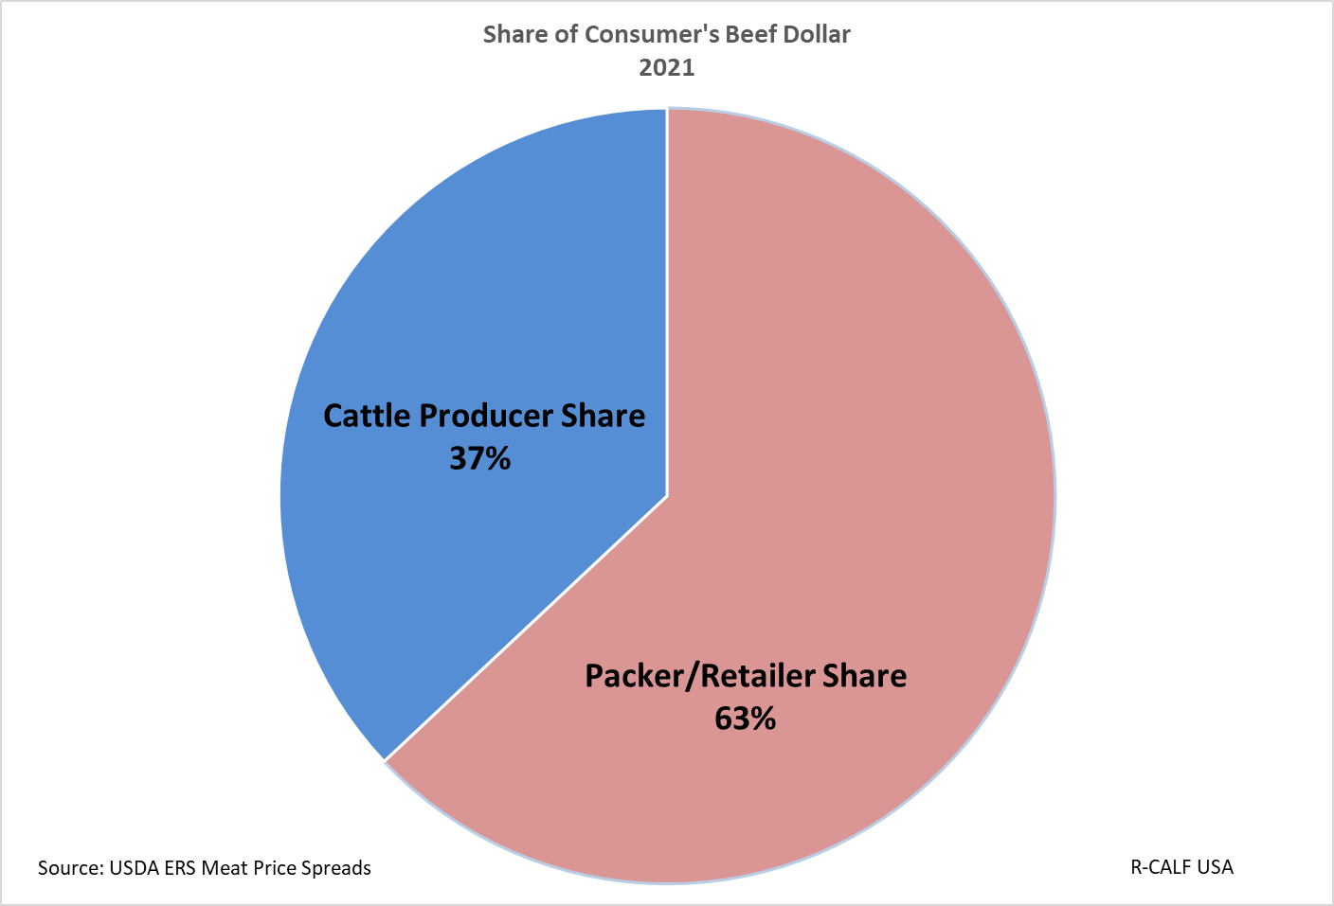
Change in Producer Share of Consumer Beef Dollar:
Complete Reversal In Four Decades

Slide 8
What The . . . ?

Slide 9


Slide 10
Decades of Denial, Inattention, and Neglect Have Rendered Your Domestic Markets for Beef and Cattle Fundamentally, Structurally, and Systemically Broken.
Your Industry Is In Crisis!

Slide 11
Why?
Concentration
Globalization
&
More . . .

Slide 12
First, The More . . .
Not a Single Agriculture Secretary for Past Several Decades Has Fulfilled His/Her Statutory Duty to:
“[S]trengthen the family farm system” of agriculture, including to develop solutions to problems faced by “small- and moderate-sized family farming operations.” 7 U.S.C. 2204 et seq.
Notes:
For decades, America has forsaken its family farmers/ranchers and instead favored corporate interests.
Evidenced by not promulgating rules to implement family farm/ranch protection provisions in the P&S Act during the past 100 years.

Slide 13
Instead, Here’s What Every Agriculture Secretary Did:
They Each Engaged in the Great Consumer Welfare Experiment
They Justified Policies that Harmed Farmers/Ranchers When Such Harms Were Offset by Theoretical Consumer Welfare Benefits
They Were Wrong! Dead Wrong!
Notes:
Christopher Leonard, Author of The Meat Racket, coined this “The Failed Consumer Welfare Experiment.”
The USDA has for decades, and continues today, to adopt policy positions that are known to cause financial harm to America’s family cattle farmers and ranchers.

Slide 14
Why USDA Facilitates Imports
“Imports of a commodity generally serve to increase net social welfare. To the extent that consumer choice is broadened and the increased supply of the imported commodity leads to a price decline, gains in consumer surplus will outweigh losses in domestic producer surplus.”
  USDA Regulatory Impact Analysis & Initial Regulatory Flexibility Analysis, January 2012, at 13, fn. 26.

Slide 15
And Here’s How Industrial Agribusinesses Exploited their Newfound Paradigm
They Infiltrated the Conventional Commodity Trade Organizations: NCBA, NPPC, National Chicken Council, etc.

Slide 16
The Industrial Agribusinesses – the Packers – Blurred the Distinction Between “Producers” of Livestock and “Producers” of Meat.
Their Mantra: What’s Good for Packers Is Good for Producers

Slide 17
Congress &
The Executive Branch Bought Into this Nonsense
Hook
Line
&
Sinker

Slide 18
Industrial Agribusinesses – the Packers – With Help From Congress and the Executive Branch Shaped a New Paradigm
They Created a Policy, Legal and Regulatory Framework to Further Their Self-Interests – at the Expense of America’s Family Farmers/Ranchers
They Changed the Rules!
(by deleting them)
Notes:
This explains the lack of antitrust enforcement, lack of P&S Act enforcement, relaxation of once stringent food safety and import standards, reduction and elimination of cattle & beef tariffs, and forcing producers to pay checkoff taxes to further the self-interests of industrial agribusinesses.
In Perhaps the most obvious change in recent decades is that large, complex farms have grown in number and are now responsible for the majority of agricultural production in the United States. Furthermore, the traditional portrayal of farms as self-contained, family-operated businesses does not accurately characterize these entities.

Slide 19
The New Market Structure Paradigm
Concentration
  Deemphasis on competition; on maintaining a widely disaggregated food production sector; and on preserving Rural America’s economic cornerstones.
  Instead, the new paradigm favored achieving efficiencies through largeness of scale and centralization.

Slide 20
The New Market Structure Paradigm Con’t.
Globalization of Input Supply Chains
  occurred immediately after market concentration (NAFTA 1994; WTO 1995)
  deemphasis of smaller, independent businesses
  Catering to the newly concentrated beef packing sector – a sector that coveted lower-cost inputs from lower production-cost countries.

Slide 21
Steppingstones to Globalization
Tokyo Round: In 60s and 70s established trade policy expressly designed to assist foreign countries by giving them greater access to our U.S. beef market.
1994 Uruguay Round with goal to “Improve market access for agricultural products so that countries will increasingly export commodities in which they have a comparative advantage,” led to very low tariffs on imported cattle and beef and establishment of generous import quotas for foreign beef imports.

Slide 22
Under this policy, the volume of beef imports grew faster than predicted and the volume of beef exports were unable to keep up, leaving the U.S. beef market awash in imported beef.
Trade relationships established to help foreign countries gain access to the U.S. market have never been changed back, even after it was clear that export markets were not reciprocating.

Slide 23
Concentration Resulted In the Dismantling of Industry’s Competitive Infrastructure
Globalization Has Stunted the Industry’s Opportunity to Expand
Notes:
That undifferentiated beef and cattle imports from Canada and Mexico function as direct substitutes for U.S. cattle and beef and cause the exodus of U.S. beef cattle operations, shrinkage of the U.S. cattle herd, and elimination of opportunities for aspiring cattle farmers and ranchers was evidenced in the 2018 U.S. International Trade Commission (USITC) investigation into the USMCA. During the investigation, the North American Meat Institute (NAMI) testified that, “The Northwest region imports 227,000 head of Canadian fat cattle per year representing approximately 19 percent of processing capacity in the region. Additionally, another 55,000 of Canadian feeder cattle are imported annually into Oregon, Washington, and Idaho, representing 8 percent of the one-time [packing] capacity [in that region].”5 The National Cattlemen’s Beef Association (NCBA) testified that “especially in the Pacific Northwest,” imports of Canadian and Mexican cattle “have supplemented seasonal shortages in our herd and helped our feed yards and packing facilities run at optimal levels.”6 Data show the number of beef cattle operations in the states of Washington, Oregon, and Idaho (the Pacific Northwest or Northwest), declined from 38,500 beef cattle farms in 1994, the year NAFTA was implemented,7 to just 28,992 beef cattle farms by 2017, the latest available census data. 8 This represents a 25% decline in the number of Pacific Northwest beef cattle farms and ranches under NAFTA. Data also show the total number of beef cows in those same states declined from 1.46 million head in 19949 to only 1.22 million head in 202110, representing a 16% decline in the number of beef cows in the states of Washington, Oregon, and Idaho under NAFTA. Thus, while the U.S. was importing 282,000 head of both fat cattle and feeder cattle from Canada and/or Mexico into the Pacific Northwest (this according to the NAMI testimony cited above), and producing undifferentiated beef from those imported cattle, the domestic beef cow herd in the Pacific Northwest shrank by about 240,000 head of cattle and over 9,500 beef cattle farms and ranches exited the U.S. cattle supply chain. These data and admissions by both the NAMI and NCBA fully support R-CALF USA’s position that increased imports of cattle from which undifferentiated beef is produced has substantively harmed the U.S. cattle supply chain by displacing U.S. cattle operations and U.S. cattle. While these empirical data provide specific evidence for the Pacific Northwest, nationwide evidence of the shrinking numbers of cattle farms and ranches and the declining number of cattle in the U.S. herd provides every indication that this same import-related harm is being exacted in every state.

Slide 24
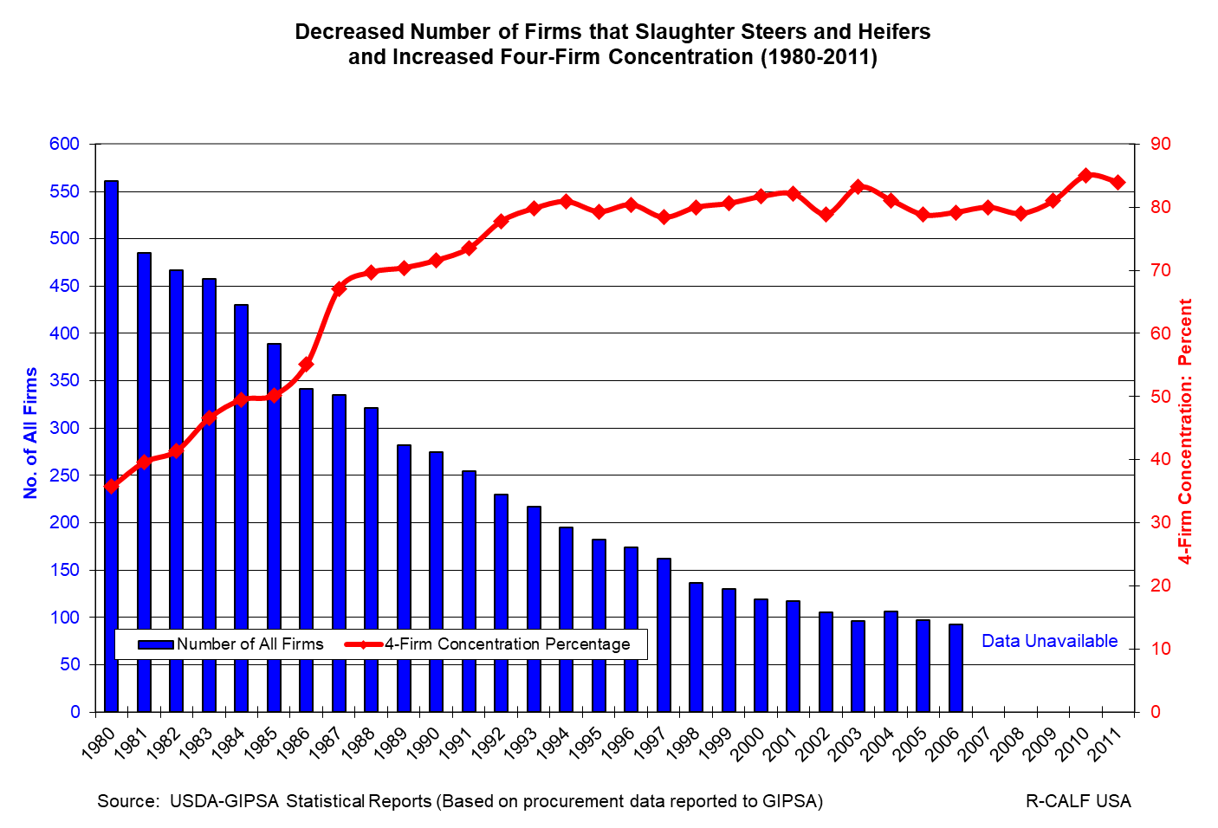
How Is Market Power Effected?

Slide 25
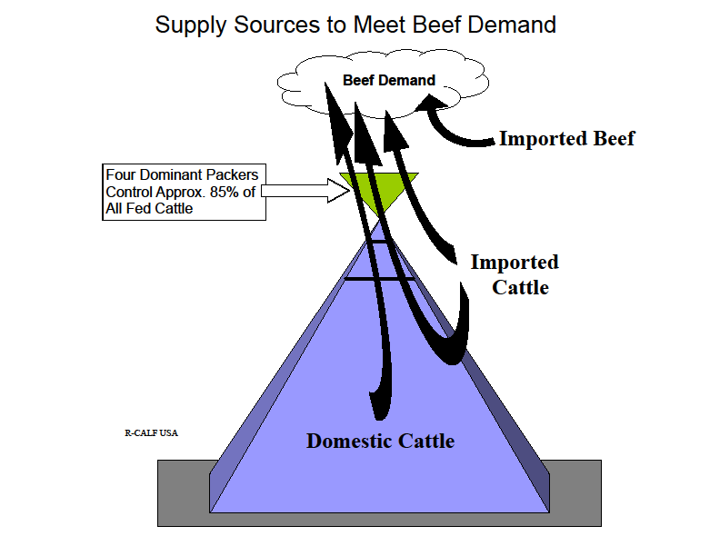
Leverage
Notes:
U.S. Farmers and Ranchers represent the domestic supply chain for the concentrated meatpackers. They are the supplier of a raw commodity and their only income is that derived from selling cattle to the packers. But, U.S. farmers and ranchers are not the only supplier of raw products as there are foreign sources the meatpackers can tap to obtain both live cattle and the beef commodity with which to satisfy consumer demand and to maximize profits. Imports accord the meatpackers leverage over domestic prices – hence the profitability of domestic producers – because they are a perfect substitute particularly when the foreign product is undifferentiated.

Slide 26
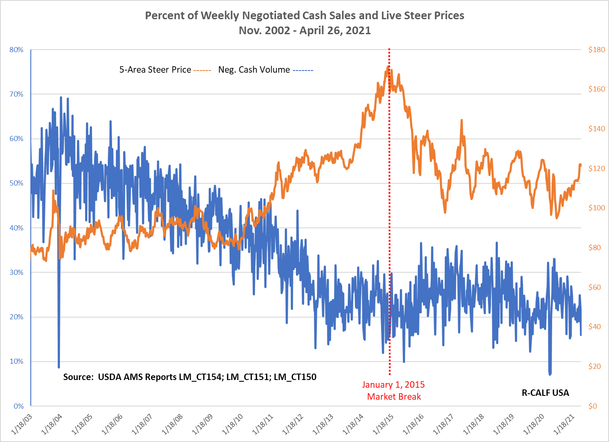

Slide 27
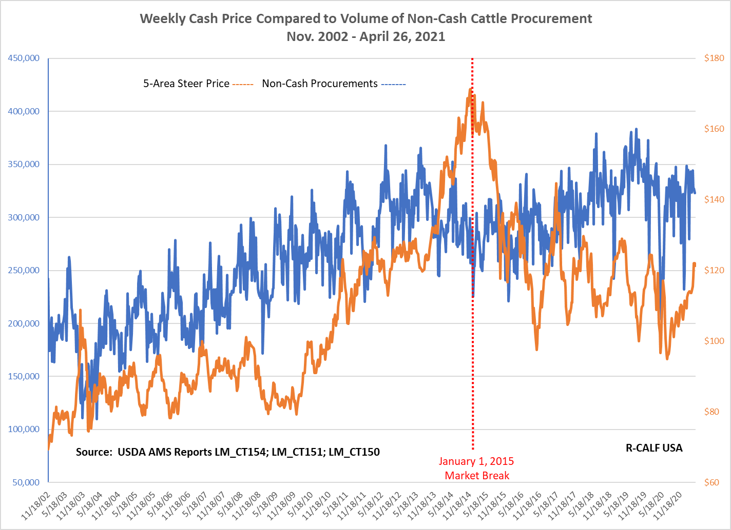

Slide 28
Indices of Chronic Structural Market Failure in the U.S. Cattle Industry

Slide 29
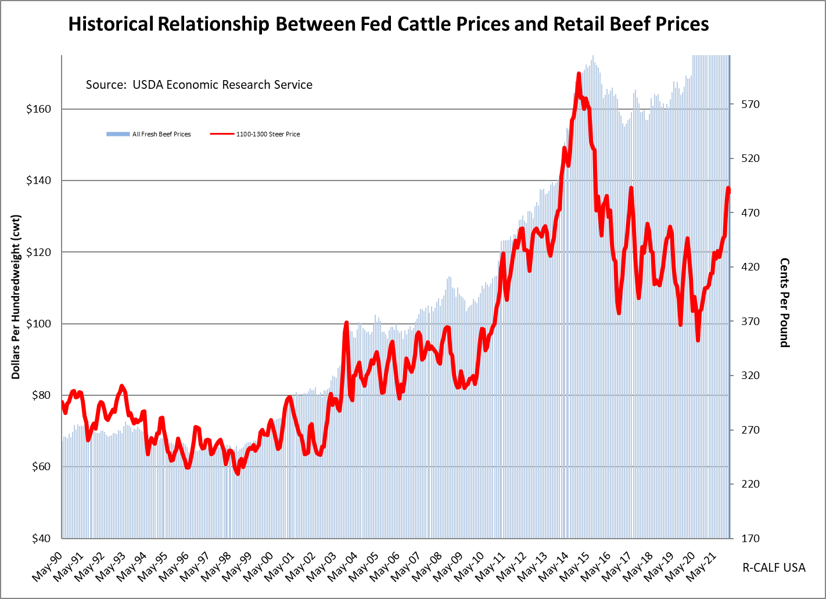
Notes:
Three decades of data.

Slide 30
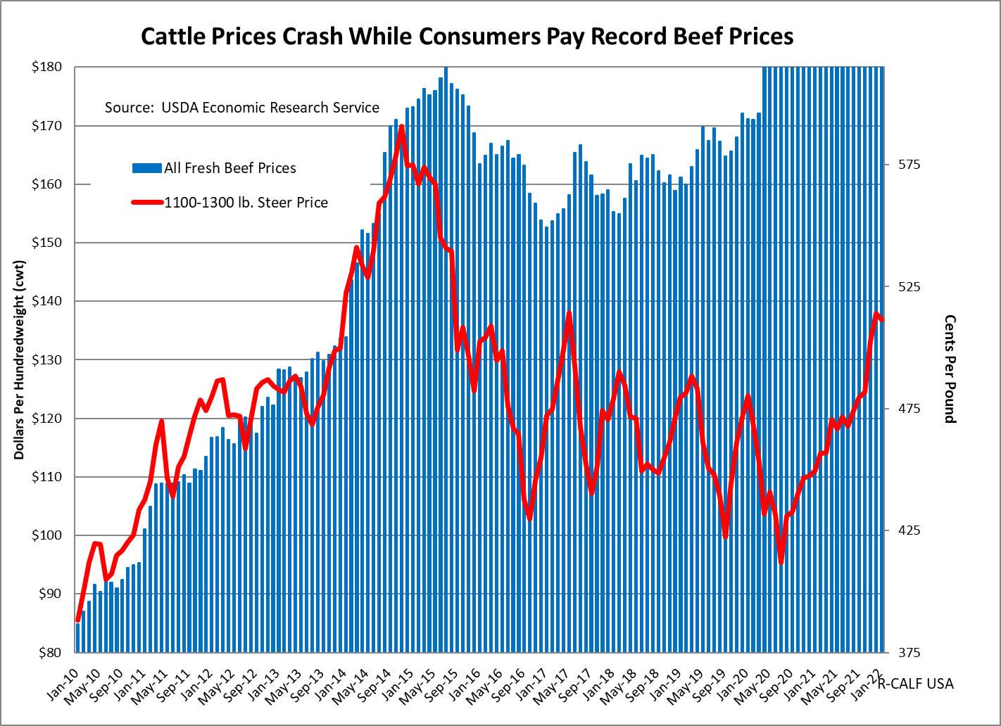

Slide 31
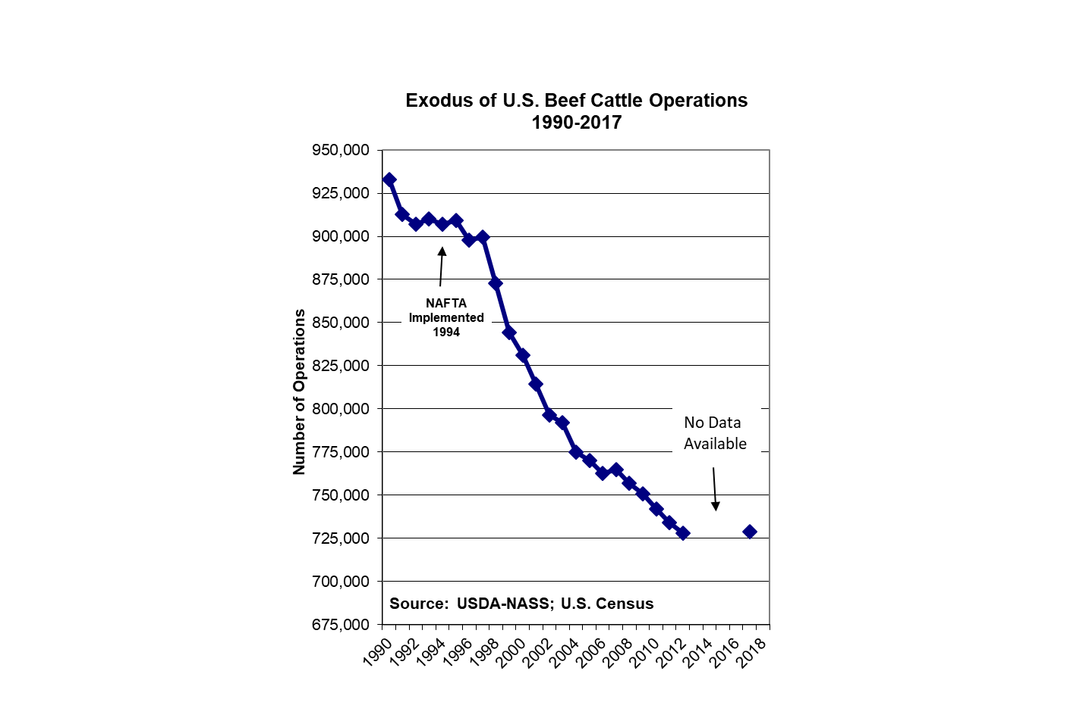

Slide 32
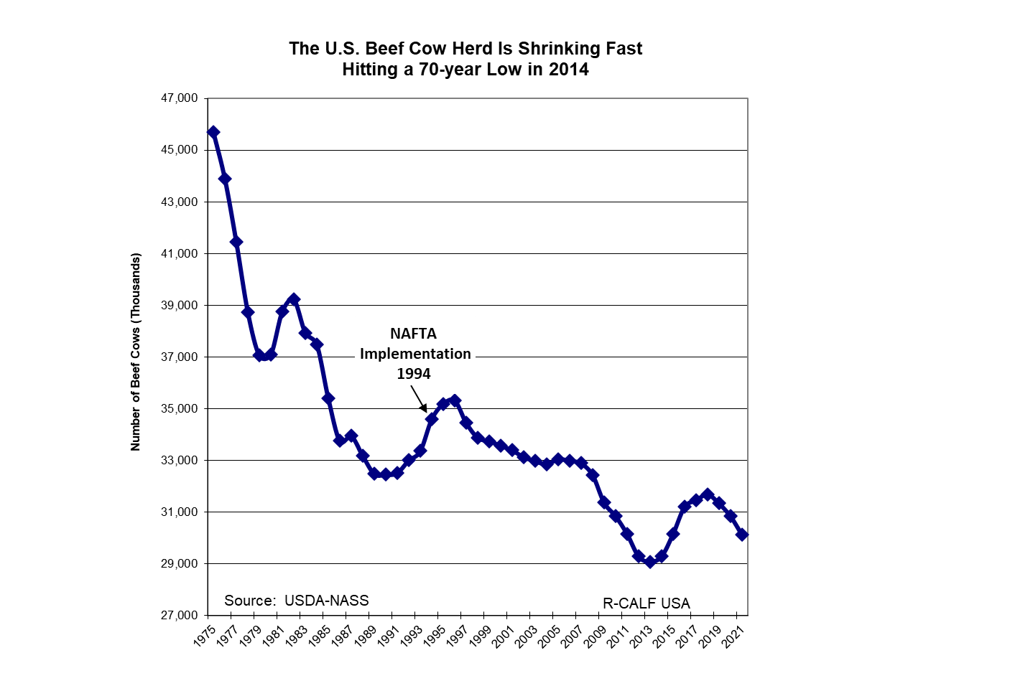
Notes:
As a result of the growing trade deficit and unfair trade practices (e.g., disallowing U.S. producers to distinguish their exclusively U.S. product in the marketplace), the U.S. cattle industry – the largest segment of American agriculture, is shrinking fast. Recently, in 2014-15, the U.S. mother cow herd fell to the lowest level in over 70 years, and well below pre-NAFTA levels. Our beef cow numbers are now nearly 3.3 million fewer than when NAFTA was implemented in 1994. All this while America’s population was exploding, increasing 24% since 1994 (increasing from 263 million to 327 million).

Slide 33
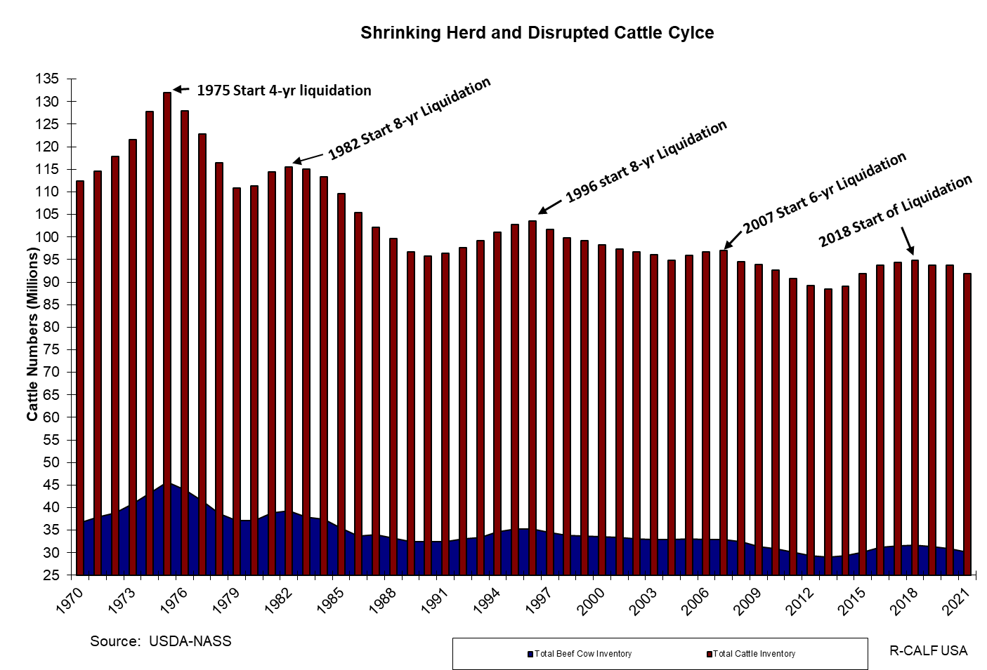
Notes:
Normal cycle: 6-7 years expansion, 1-2 years consolidation, 3-4 years liquidation.

Slide 34
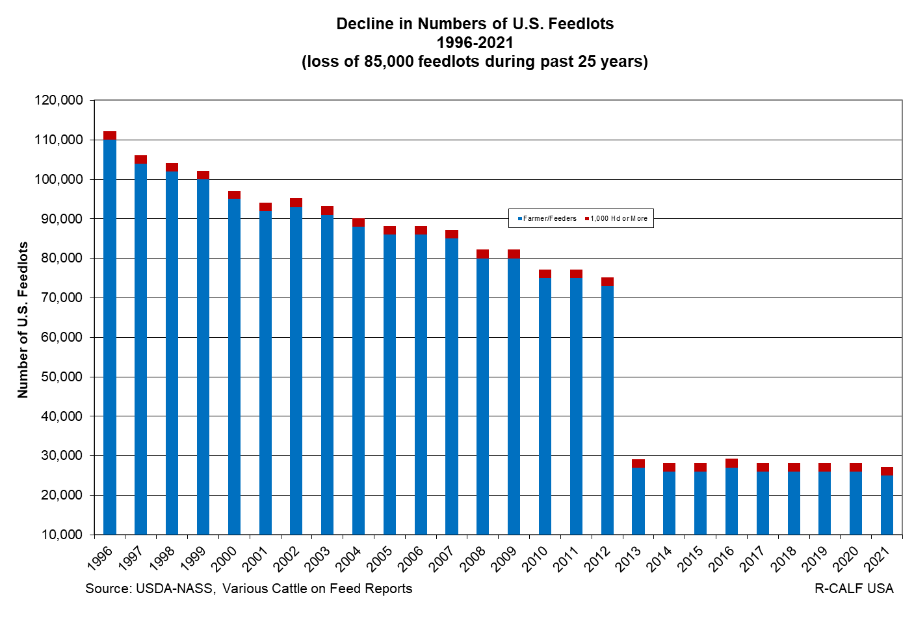
Notes:
During the past 26 years, while NAFTA has been in place, 75 percent of all U.S. feedlot operations have disappeared, meaning there are nearly 85,000 fewer buyers to purchase the 25-26 million cattle that are raised each year by the 729,000 widely dispersed independent U.S. cattle farmers and ranchers.

Slide 35
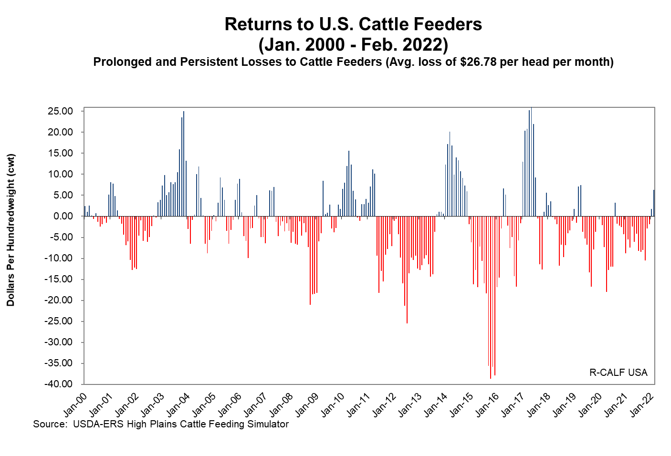
Notes:
Avg. Loss based on 1,300 lb. Steer. Loss since January 2015 is a negative $65.91 avg. loss per month.

Slide 36
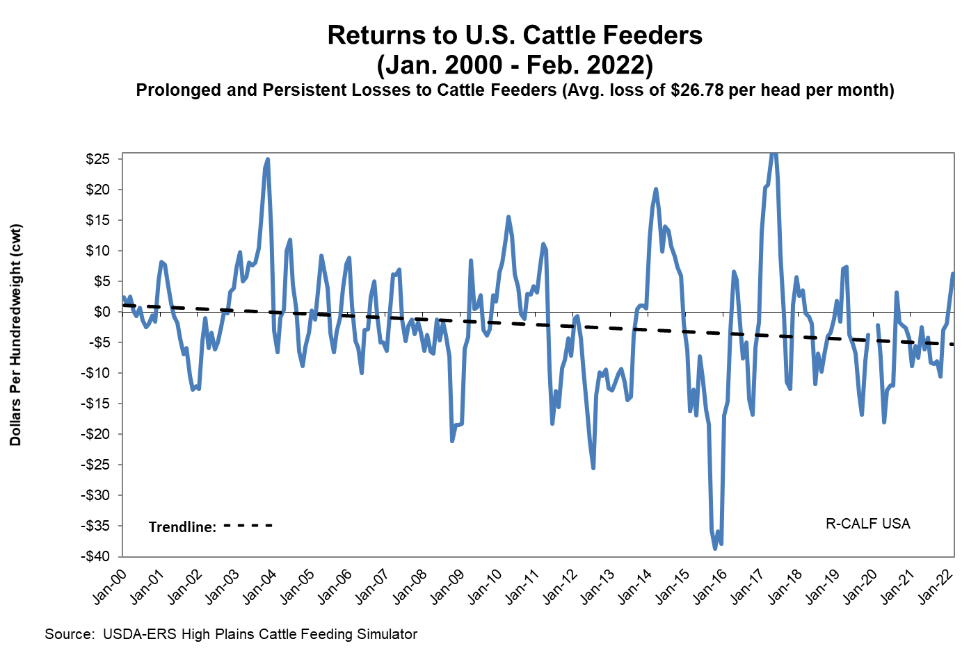
Notes:
Avg. Loss based on 1,300 lb. Steer. Loss since January 2015 is a negative $65.91 avg. loss per month.

Slide 37
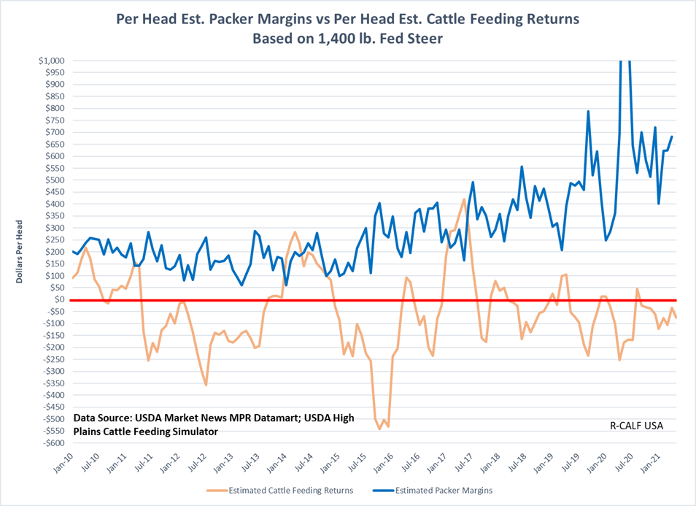

Slide 38
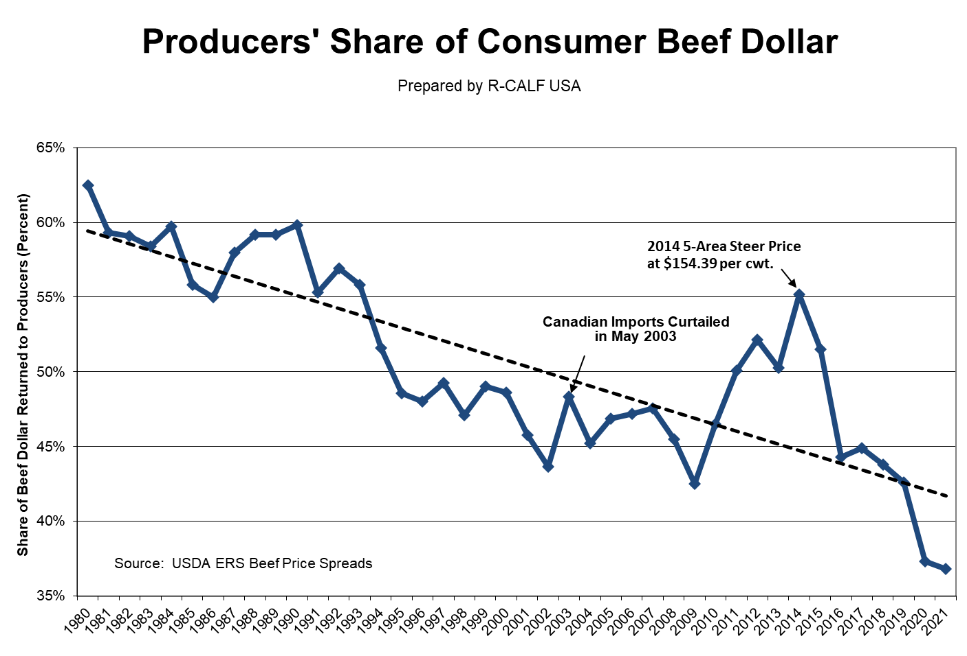

Slide 39
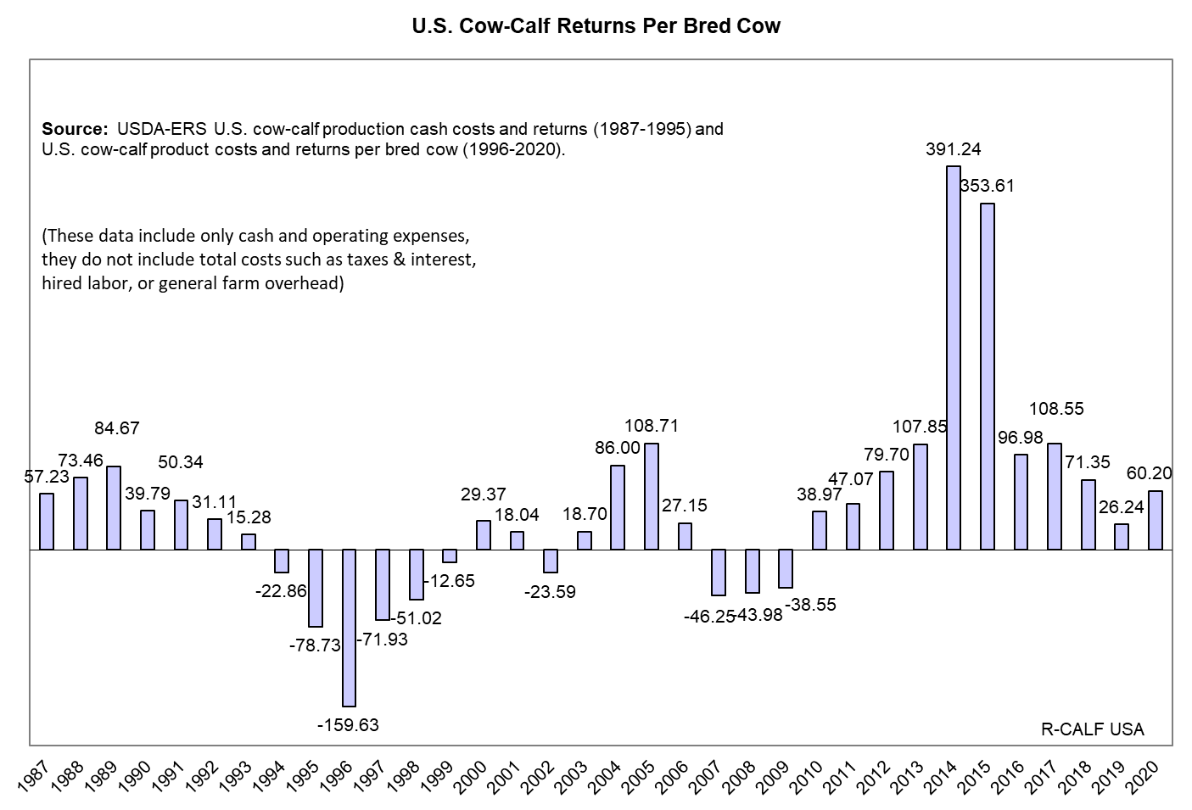

Slide 40
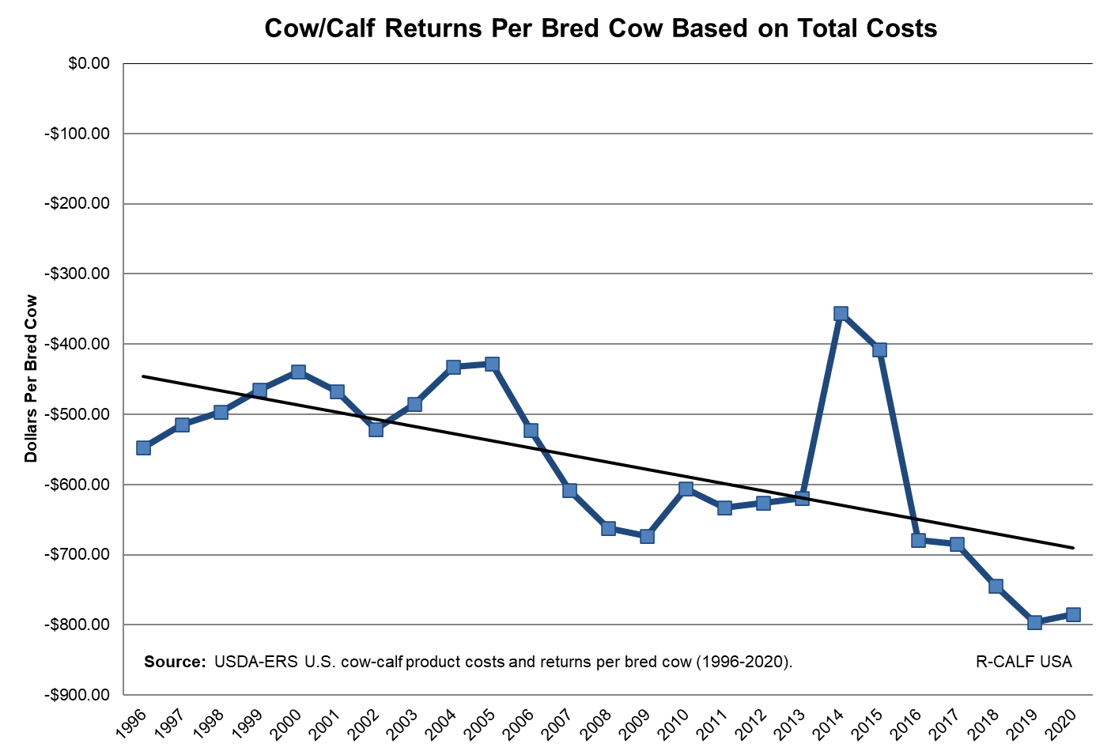

Slide 41
Trade

Slide 42
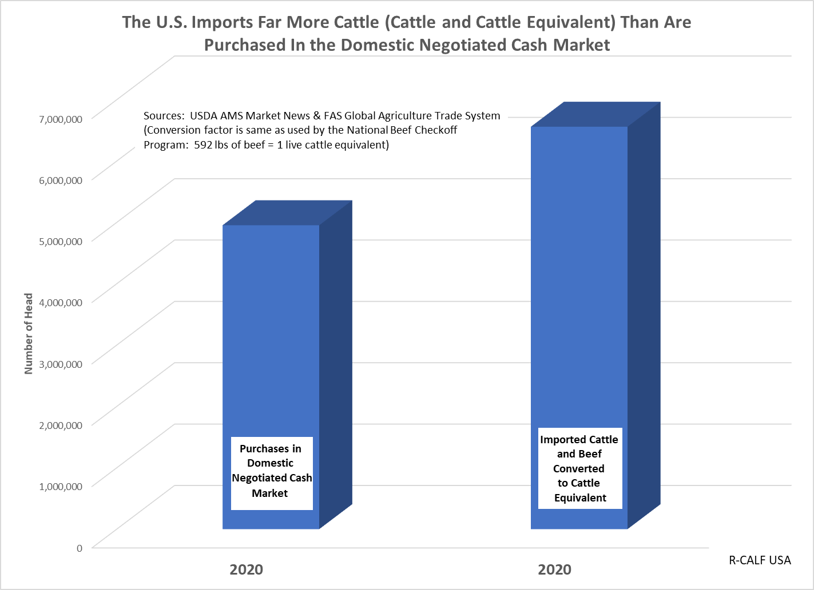
Trade Flows

Slide 43
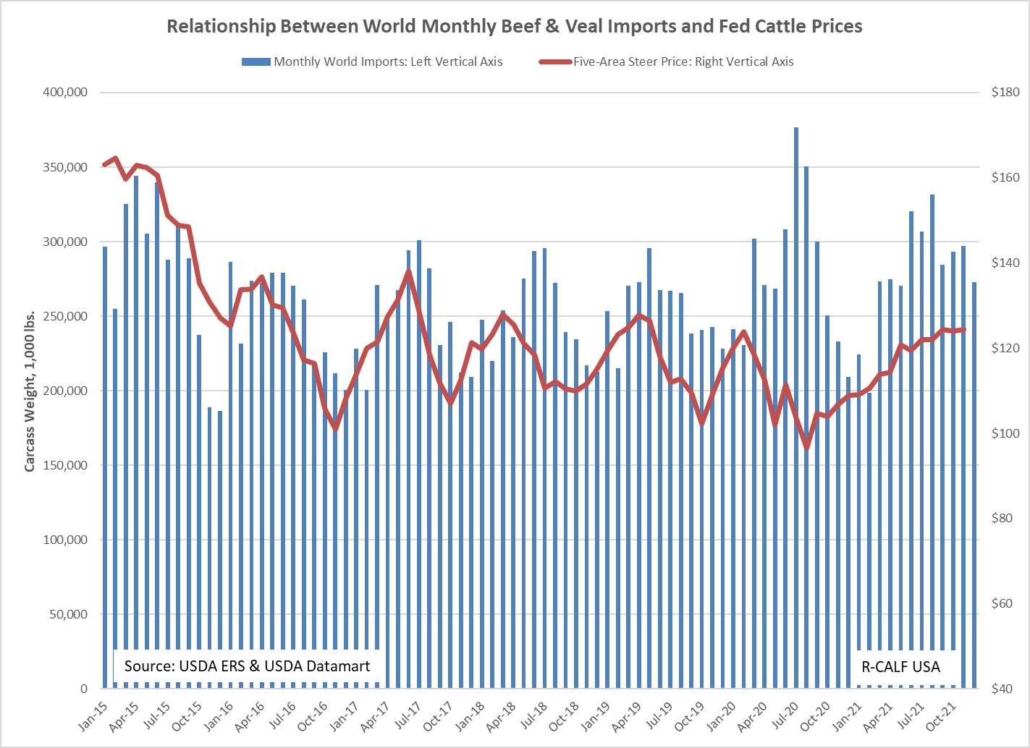

Slide 44
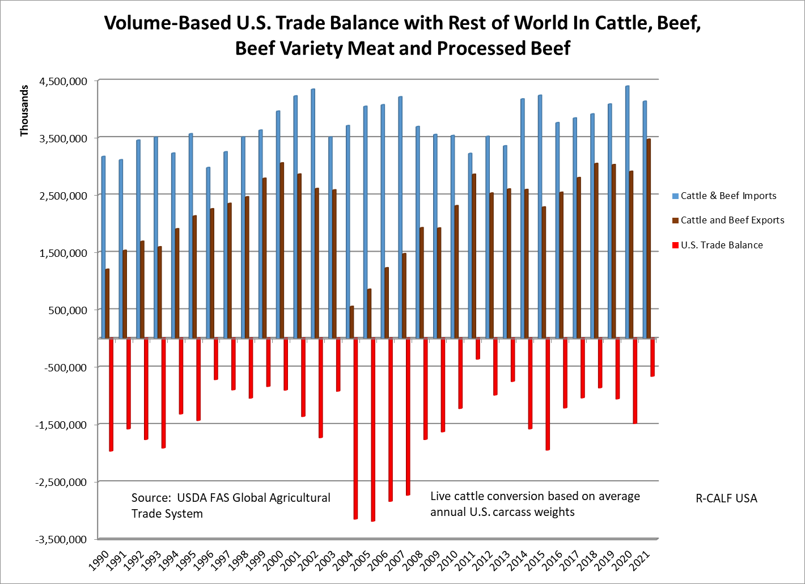

Slide 45
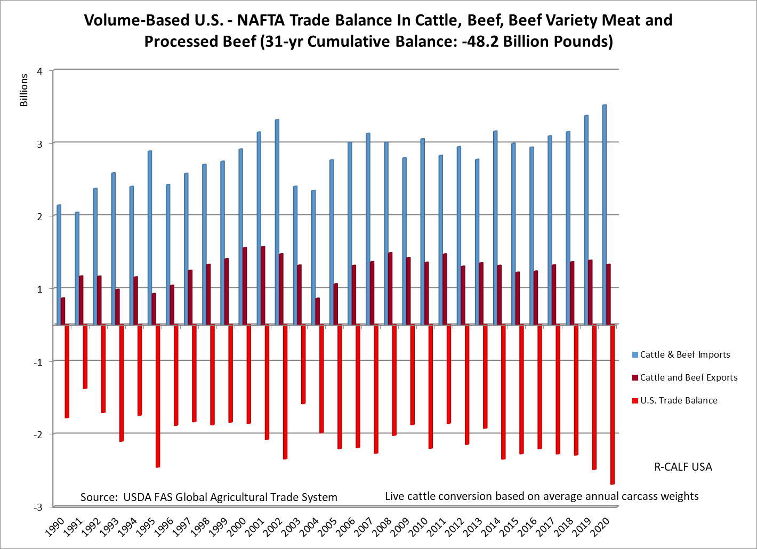
Notes:
So let’s look at the United States trade history with the two countries that are touted as America’s most important trading partners – Canada and Mexico.

Slide 46
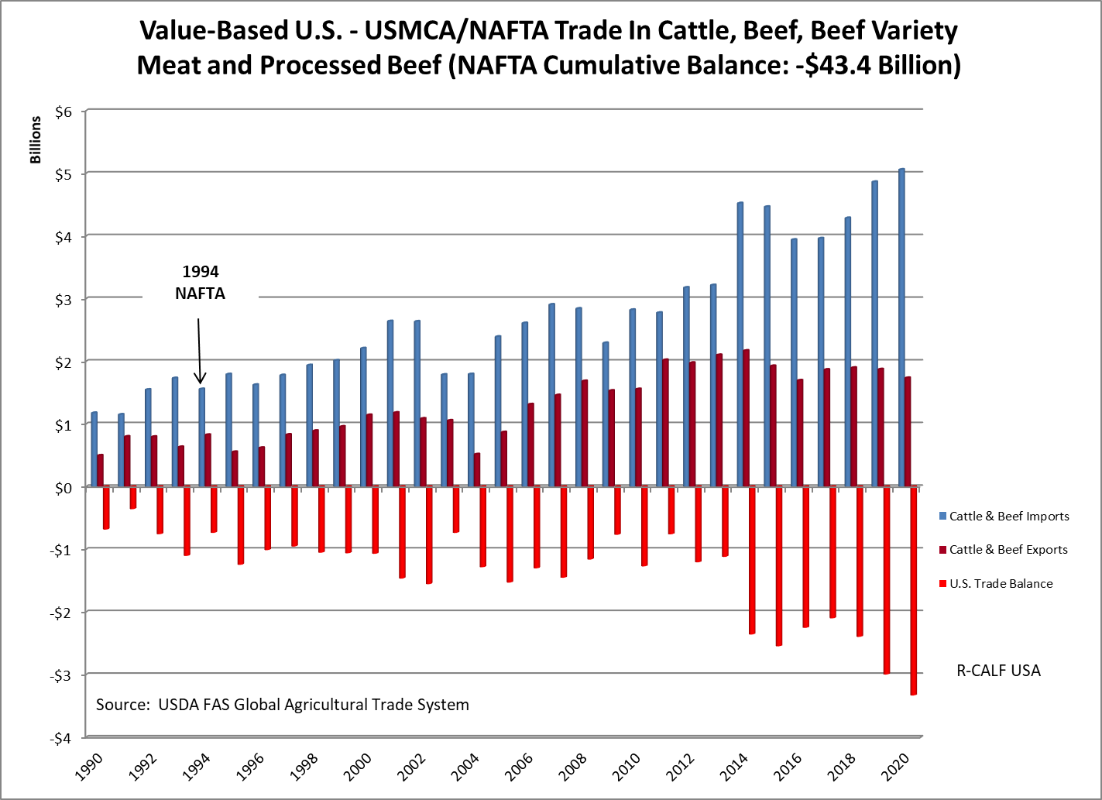

Slide 47
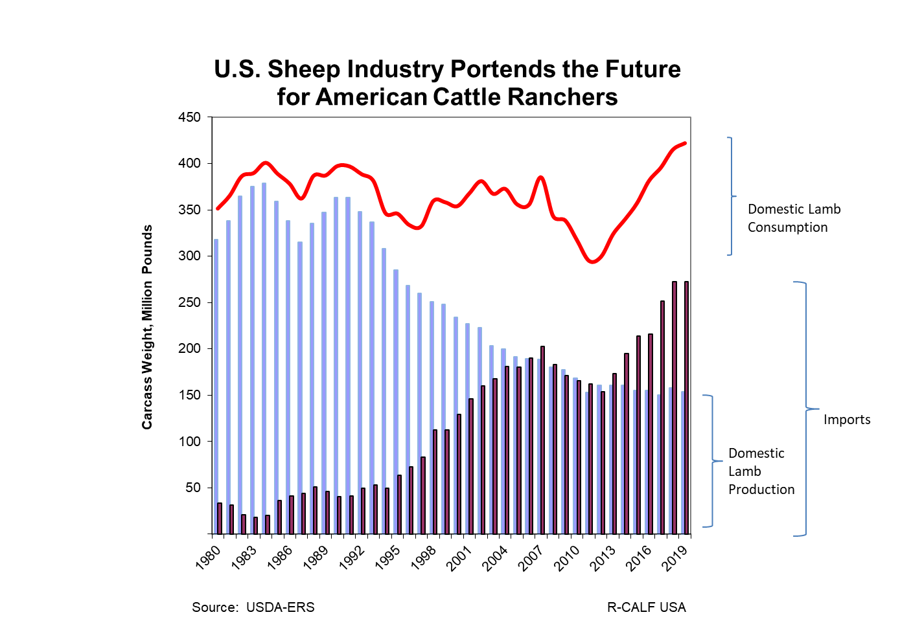
Notes:
So what impact will continually increasing imports have on the U.S. cattle industry? It must be noted that the cattle industry is unique among most agriculture industries (e.g. corn, wheat and cotton) because it underproduces for the U.S. market. We need only look at what has happened to our similarly situated U.S. sheep industry, which is a closely related sister industry to the cattle industry. In the sheep industry, imports began displacing domestic production in the early 90s and by 2006 the U.S. sheep industry earned the distinction of being the first U.S. livestock sector to be effectively outsourced. From 2006 to present, U.S. consumers have been consuming far more imported lamb than domestic lamb because our U.S. sheep industry had been severely decimated. The USDA stated that imported lamb carcasses were bringing about $55 dollars less per carcass than domestic lamb carcasses, and the cheaper imported carcasses helped shrink our U.S. sheep industry. This is the same trajectory that the U.S. cattle industry is on if we don’t make fundamental changes to U.S. trade policy.

Slide 48
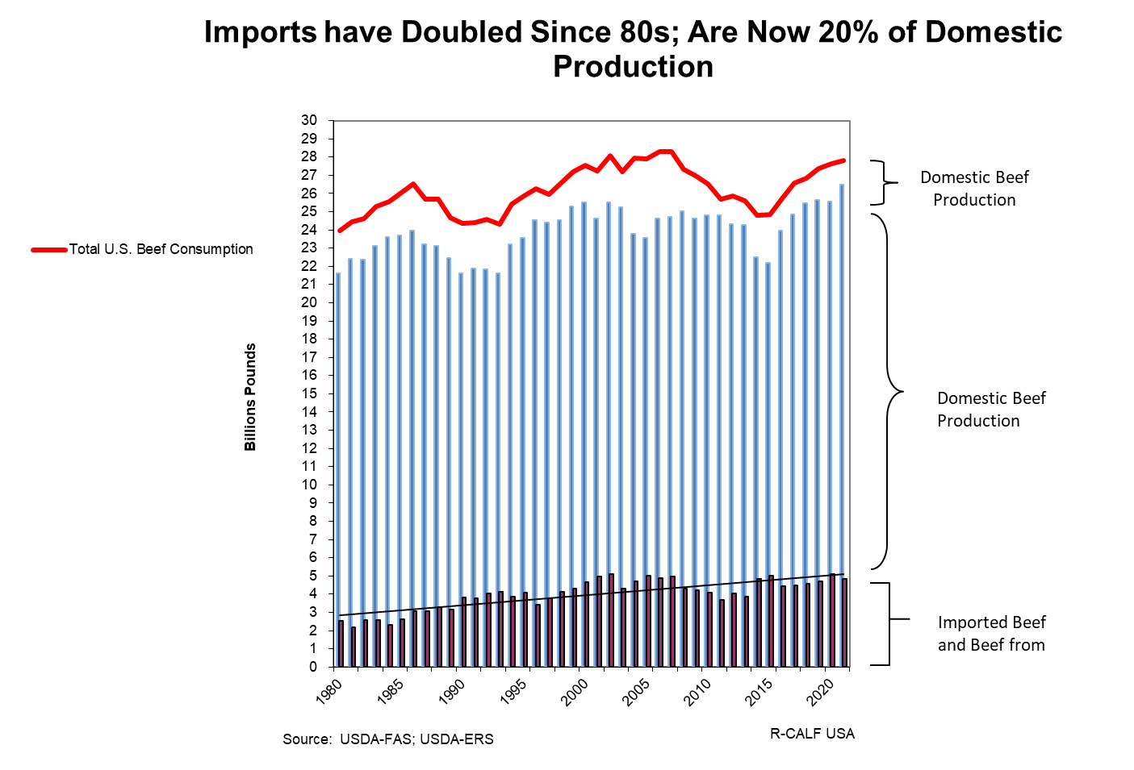

Slide 49
Solutions

Slide 50
Restore Competition in the Domestic Beef Market
First Step to Address Globalization
Require All Beef Sold in America to be Labeled With Its Country of Origin
www.labelourbeef.com

Slide 51
“In short, beef is beef, whether the cattle were born in Montana, Manitoba, or Mazatlán. The same goes for hogs, chickens, and other livestock.”
NCBA, et al. vs USDA, July 2013

Slide 52
“There is another obvious lawful explanation for increased imports. In 2016, Congress repealed the Mandatory Country of Origin Labeling (COOL) rule for beef. . . When the rule was in place, domestic feedlots could charge higher prices than foreign feedlots because of the premium paid for domestic beef. . . After the rule was repealed, foreign beef no longer had to be labelled as such. That spurred additional imports and caused domestic cattle prices to fall.”
The above quote is found on pages 33-34 in the Defendant’s Nov. 13, 2019 joint brief in support of their motion to dismiss our pending antitrust lawsuit.

Slide 53
Restore Competition in the Domestic Cattle Market
First Step to Address Concentration
Force Packers to Compete for Domestic Cattle Supplies: Mandate Minimum 50% Negotiated Cash Purchases

Slide 54
This is a Call to Action
Call each of your members of Congress and tell them:
  Support and quickly pass S.949, the Grassley/Tester bill that will revive the dysfunctional fed cattle market.
  Support and quickly pass the Thune/Tester/Rounds/Booker bill, the American Beef Labeling Act, S.2716, that restores mandatory country of origin labeling for beef.

Slide 55
Your Broken Cattle Market Will Not Fix Itself.
If You Do Not Act Now, Your Marketplace Will Soon Look Like the Vertically Controlled Poultry and Hog Markets.

Slide 56
The New Frontier For Cattle Associations
Litigation

Slide 57


Fed Cattle Cartel Litigation
SCOTT+SCOTT ATTORNEYS AT LAW LLP
CAFFERTY CLOBES
MERIWETHER & SPRENGLE LLP
June 2019

Slide 59
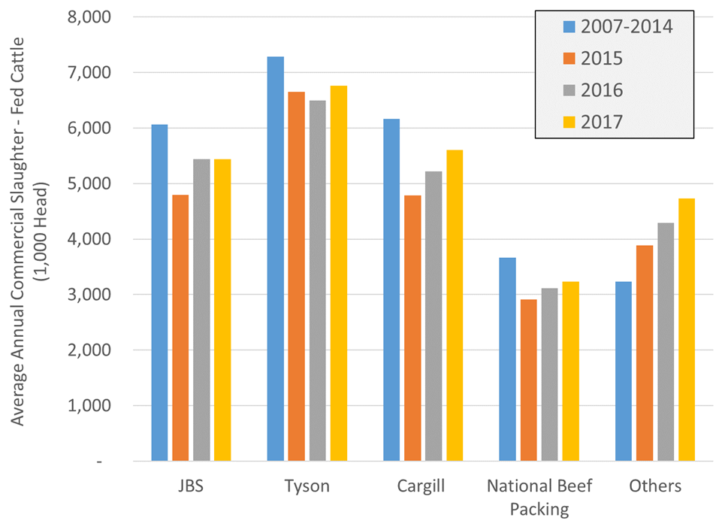
Average Pre- & Post-Class Period Fed Cattle Slaughter – Packing Defendants vs Others

Slide 60

THE CLAIM: ON WHOSE BEHALF?
+
Two classes.
Fed Cattle Producers: all persons within the U.S. who directly sold to a defendant one or more fed cattle during the class period (January 2015 – present).
Exchange Traders: All persons who transacted live cattle futures or options contracts on the CME during the class period (January 2015 – present).
+
+
claim does not cover:
Conduct prior to 2015.
Sale of cows and bulls.
Loss suffered by cow/calf producers and backgrounders who didn’t sell fed cattle directly to the defendants.
Federal antitrust law privileges claimants with a direct relationship with the wrongdoers.

Slide 61
THE CLAIM: KEY ALLEGATIONS
+
+
Defendants worked together to depress fed cattle prices from 2015 onwards.
Collusion encompassed five key elements:
  Periodic slaughter reductions
  Reduction in cash cattle purchases during periods of slaughter restraint
  Coordination of defendants’ cash cattle procurement
  Importation of foreign live cattle at a loss
  Shuttering slaughter capacity
Depression of fed cattle prices impacted cattle futures/options.
+

Slide 62
EVIDENCE RELIED UPON
SLAUGHTER REDUCTION/CASH CATTLE TRADE ALLEGATIONS
Defendants alleged to have agreed to periodically reduced their slaughter volumes to ensure their demand for fed cattle didn’t exceed the available supply.
During these periods, the defendants are alleged to have simultaneously reduced their cash cattle purchases with the intent of “backing up” slaughter ready cattle.
This encouraged cash cattle producers to accept lower prices and/or commit their cattle on captive supply agreements.
The drop in cash prices lowered the price of defendants’ captive cattle
Allegations supported by witness and economic evidence.
Confidential witness, a former employee of one of the defendants, confirmed the existence of an agreement amongst the defendants to reduce slaughter levels.

Slide 63
TIMELINE: THE PROCESS
+
Case filed in Minnesota Federal Court.
Court will appoint lead plaintiffs and counsel.
+
Claim will likely take at least three to four years.
Exact timeline difficult to predict.
+
FIRST SIGNIFICANT EVENT: Defendants’ motion to dismiss.
Defendants will argue that the complaint fails to plead a legally arguable claim.
If the Court rejects the defendants’ arguments the parties will move onto discovery.

Slide 64
R-CALF’S MISSION: PROTECTING CATTLE PRODUCERS
+
Government authorities haven’t shown an inclination to commence an antitrust investigation.
+
Change must be driven by industry participants.
Opportunity to recover alleged harm.
+
Producers have suffered historic losses since 2015.
R-CALF’s participation supports the other representative plaintiffs.
It is important that producers support those who have been willing to go to bat for their fellow producers.

Slide 65
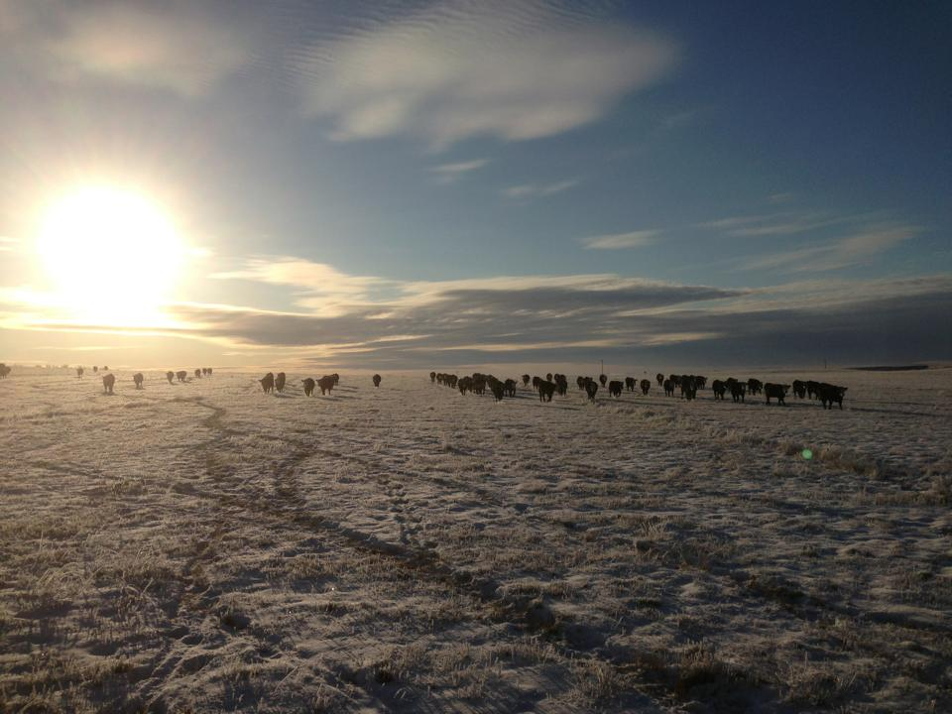
The End
(Actually the New Beginning)

