Slide 1
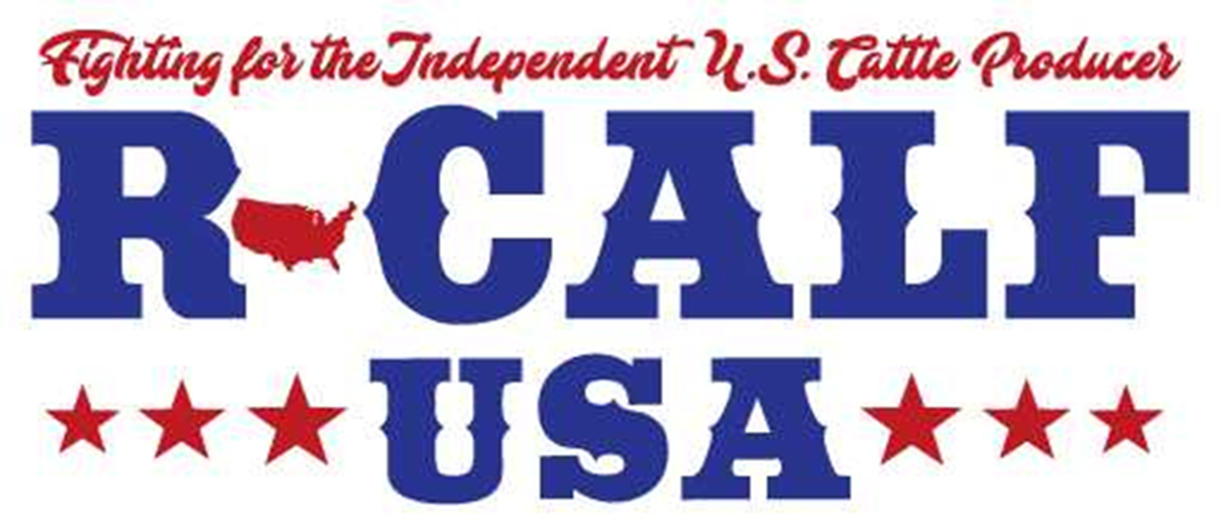
Three Black Swans
Presentation By R-CALF USA
April 27, 2021

Slide 2
A Black Swan Event Occurs When Markets Respond Counter to Market Fundamentals, Such as When Cattle Prices Fall in Response to Rising Wholesale Beef Prices

Slide 3
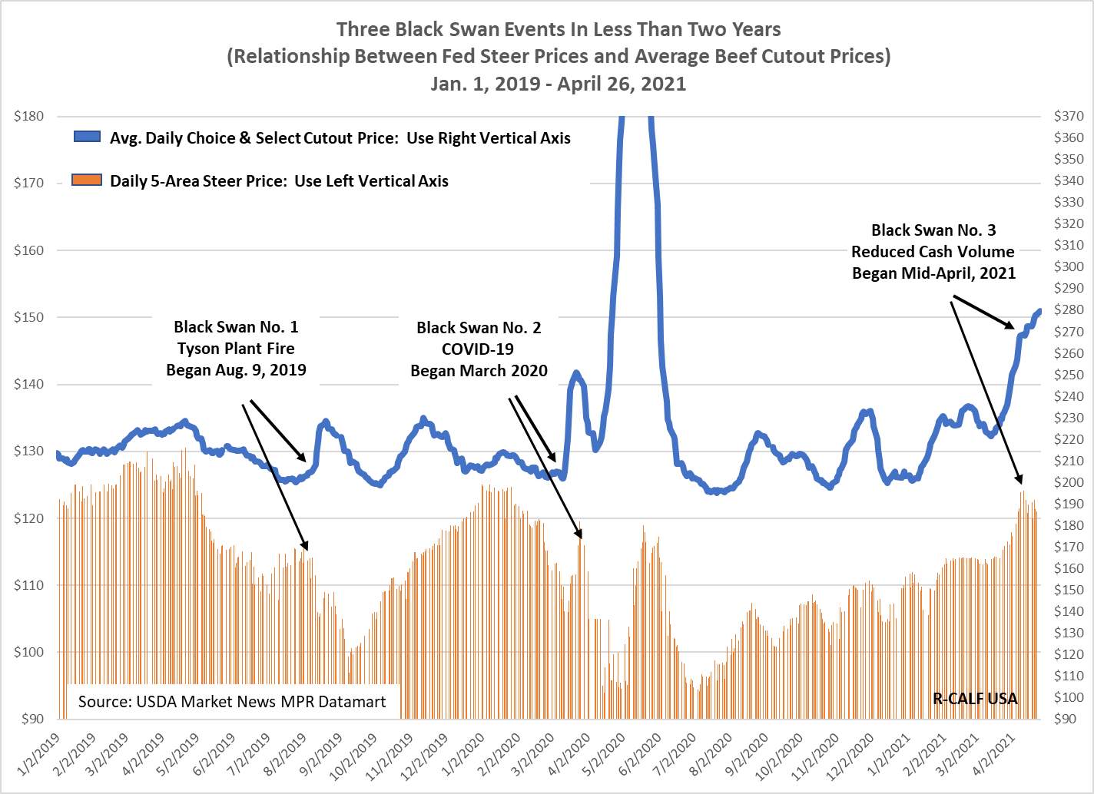

Slide 4
Black Swan Events Also Occur When Markets Overreact to Seemingly Minor Stimuli, Such as Where Packer Margins Reach Super-High Levels When the Negotiated Cash Market Volume Is Reduced.

Slide 5
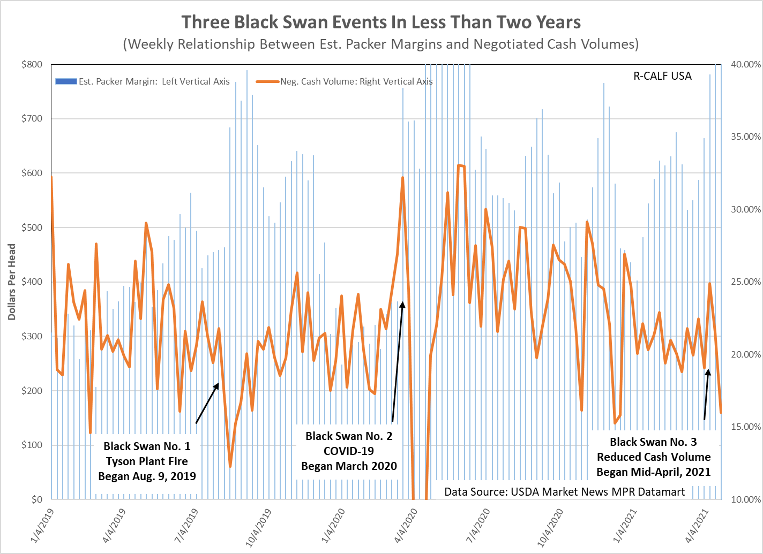

Slide 6
The Accumulation of Historically High Captive Supply Levels Coincide with the 2015 Market Break. Even Higher Levels Post 2015 Coincide with Ever Falling Cattle Prices.

Slide 7
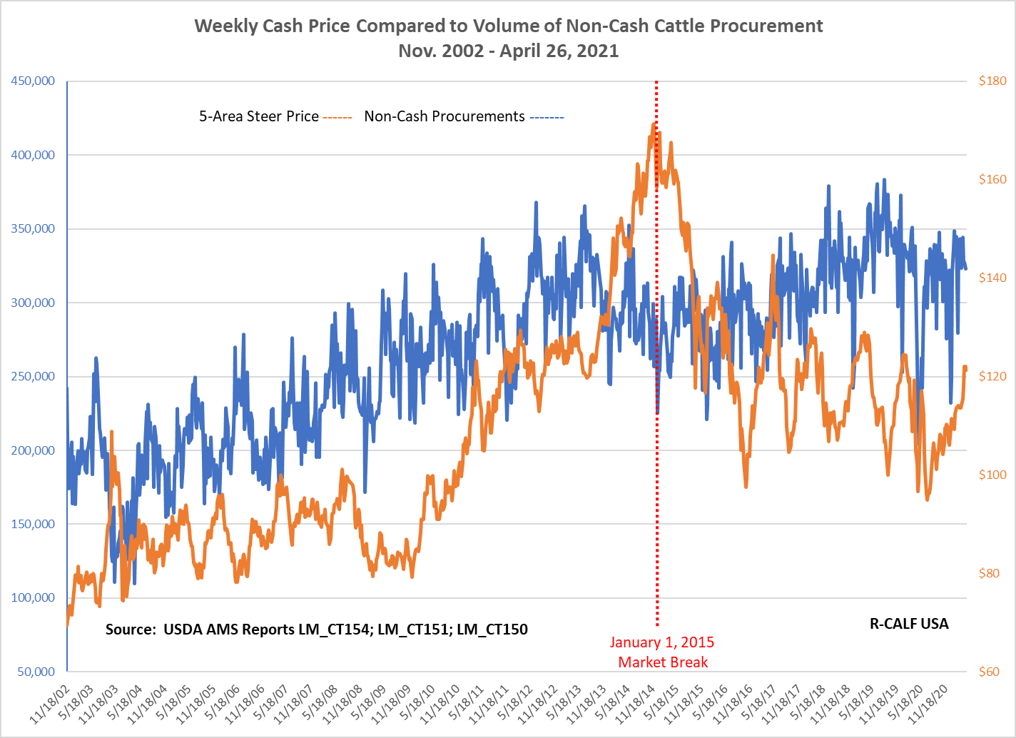

Slide 8
Since 2015 There Have Been Six Clusters of Monthly Import Spikes, Each Coinciding With Six Downturns in the Fed Cattle Market.

Slide 9
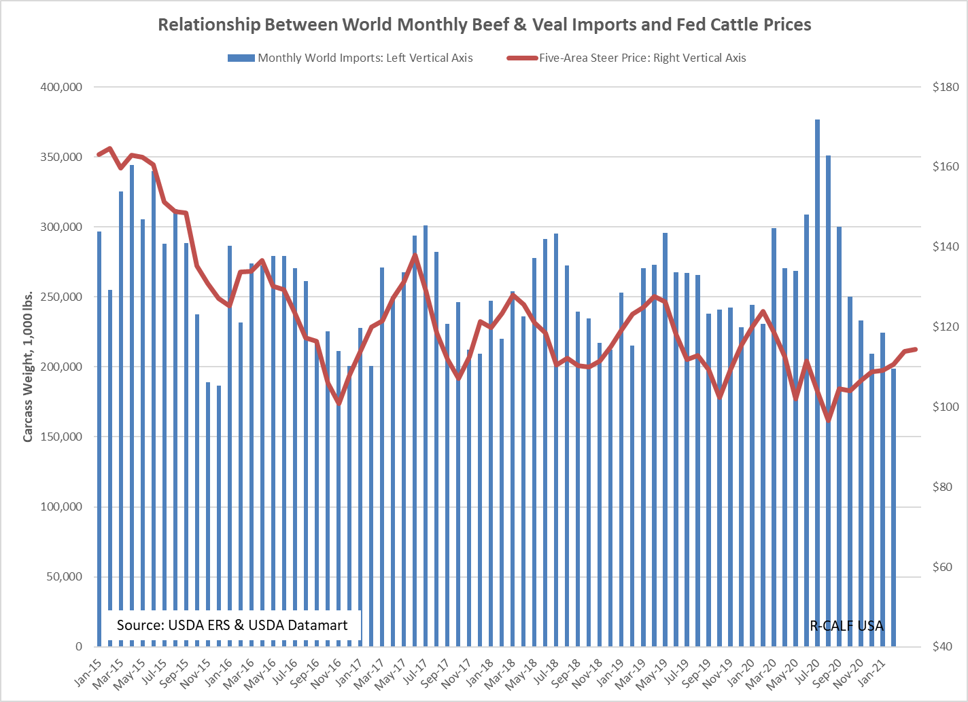

Slide 10
Are These Correlated Events Coincidence or Design? Cattle Producers Must Decide, and Fast.

Slide 11
Your Broken Cattle Market Will Not Fix Itself. If You Do Not Act Now, Your Marketplace Will Soon Look Like the Vertically Controlled Poultry and Hog Markets.

Slide 12
This is a Call to Action
Go to www.checkoffvote.com and sign the petition for a producer referendum of the mandatory beef checkoff program.
Call each of your members of Congress and tell them:
Support and quickly pass S.949, the Grassley/Tester bill that will revive the dysfunctional fed cattle market.
Introduce and pass new legislation to restore mandatory country of origin labeling for beef.

