Slide 1
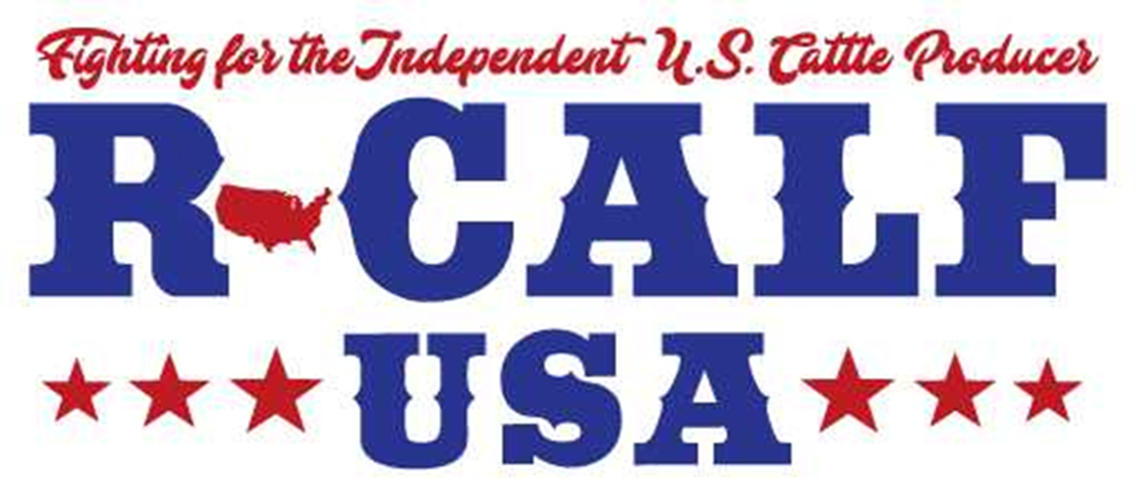
Mandatory Country of Origin Labeling Report
Mike Schultz
August 21, 2020

Slide 2
2019 R-CALF USA Board and Committee Chairs

Slide 3
1998 USITC TRADE CASE Dispute over Live cattle imports from Canada and Mexico
https://www.usitc.gov/publications/701_731/pub3155.pdf
Pages 30-31 a relatively small volume of imports can have a significant effect on domestic prices. In light of the foregoing, we find, for purposes of these preliminary determinations, that the significant, albeit relatively small, volume of imports from Canada and their market share have depressed domestic prices or suppressed price increases to a significant degree.
Furthermore, there is evidence of consistent underselling by the imports from Canada during all reporting periods, we have not given this evidence significant weight, in light of the pricing practices for this commodity agricultural product

Slide 4
WTO RULINGS Key Word COULD…
The World Trade Organization ruled today that the United States' country-of-origin labeling (COOL) law for beef and pork was discriminatory and said Canada and Mexico COULD impose retaliatory tariffs of $1.1 billion (Canadian) and $227.8 million (US) respectively.Dec 7, 2015
Should have been arbitrated but Kansas Senator and AG Chairman Pat Roberts “FAILED MISERABLY”!

Slide 5
There is considerable debate regarding the impact that mandatory country-of-origin labeling (COOL) had on both the demand for and price of domestic cattle while it was in full effect and following its repeal. Here is what the nation’s four largest packers – Tyson, JBS, Cargill, and National Beef, wrote in their November 13, 2019 joint brief in support of their joint motion to dismiss our pending antitrust lawsuit:

Slide 6
“There is another obvious lawful explanation for increased imports. In 2016, Congress repealed the Mandatory Country of Origin Labeling (COOL) rule for beef. . . When the rule was in place, domestic feedlots could charge higher prices than foreign feedlots because of the premium paid for domestic beef. . . After the rule was repealed, foreign beef no longer had to be labelled as such. That spurred additional imports and caused domestic cattle prices to fall.” The above quote is found on pages 33-34 in the Defendant’s Nov. 13, 2019 joint brief in support of their motion to dismiss our pending antitrust lawsuit.

Slide 7
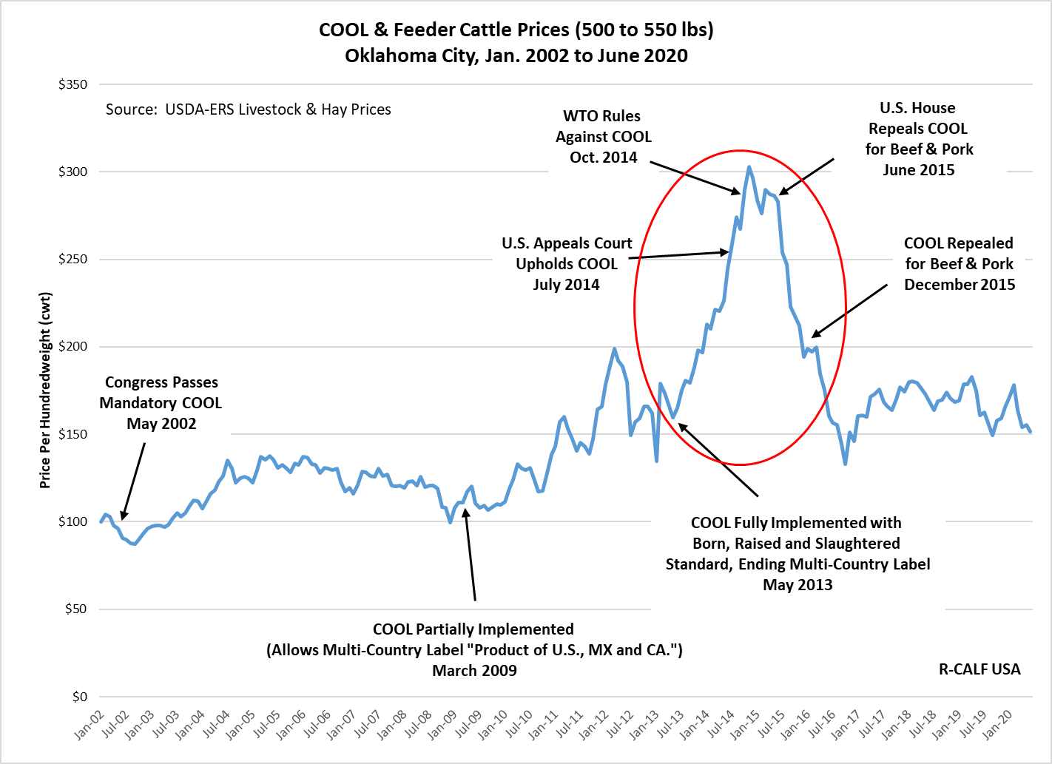
Notes:
Lost $397 per head Oct. 14 to Oct 15.
Lost $464 per head Oct. 15 to Oct 16.
Total loss Oct. 14 to Oct. 16 was $860 per head for 550 lb. calf
After COOL was repealed in December 2015, calf prices continued falling an additional $61 per cwt from Dec 2015 through Oct 2016.

Slide 8
Canadian Price Chart

Slide 9
CANADIAN MARKET NEWS
2018 INDUSTRY STATS:
The Canadian beef industry ships to 56 countries but is reliant on the U.S. for 74% of all beef exports. The next largest export markets are Japan (8%), China and Hong Kong (7.7%), Mexico (4%). Southeast Asia 1/8% and South Korea 1% accounting for 97% of the exports. All other markets together represent the remaining 3%
The fight is not against the producers in the other countries, it is the lack of competition and abuse by the multinational meat packers who work both sides of the borders.

Slide 10
Why USDA Facilitates Imports
“Imports of a commodity generally serve to increase net social welfare”.
“Show me one producers check for a pound of beef or bushel of grain from a multinational corporation for any exported product we raise”.

Slide 11
Restoring MCOOL in Wake of WTO Ruling
Reduce the record-keeping burden for imported livestock.
Provide Importers opportunity to improve the accuracy of labels.
Expand the scope of beef muscle cuts covered by COOL requirements.
eliminate unnecessary exemptions
broaden the definition of retailer
empower food service establishments to provide origin information on beef

Slide 12
From Where We Import Beef
Beef and veal: annual and cumulative year-to-date U.S. trade (carcass weight, 1,000 pounds)
Import country name |  |  | 2013 | 2014 | 2015 | 2016 | 2017 | Jan-Oct 18
Beef and veal imports |  | Australia | 623,889 | 1,082,676 | 1,258,200 | 767,144 | 694,929 | 575,146
 |  | Canada | 538,065 | 602,157 | 628,448 | 717,777 | 741,328 | 662,954
 |  | New Zealand | 526,046 | 597,115 | 661,687 | 612,549 | 556,965 | 525,548
 |  | Brazil | 97,202 | 81,463 | 149,580 | 152,703 | 137,906 | 117,845
 |  | Uruguay | 82,584 | 91,859 | 136,949 | 120,704 | 120,476 | 96,231
 |  | Argentina | 4,307 | 1,930 | 1,290 |  |  | 102
 |  | Mexico | 251,563 | 310,155 | 391,937 | 493,421 | 573,564 | 423,330
 |  | Nicaragua | 91,413 | 138,972 | 103,834 | 111,244 | 133,341 | 132,721
 |  | Costa Rica | 21,310 | 28,859 | 27,580 | 27,505 | 24,268 | 20,530
 |  | Honduras | 12,243 | 9,033 | 3,356 | 66 | 1,987 | 4,663
 |  | Guatemala | 57
 |  | Chile | 6 | 594 | 1,658 | 1,778 | 667 | 56
 |  | Denmark | 132 |  | 25 | 25 | 28
 |  | Croatia | 17 | 21 | 15 | 18 | 6 | 15
 |  | Ireland |  |  | 3,108 | 5,146 | 4,350 | 3,260
 |  | Japan | 777 | 1,984 | 627 | 1,013 | 1,053 | 2,947
 |  | Netherlands |  |  |  | 364 | 2,272 | 2,827
 |  | Italy |  |  | 1
 |  | Belgium |  |  |  | 72 |  | 105
 |  | Poland |  |  | 8 | 41 | 42 | 32
 |  | France |  |  |  |  | 99 | 202
 |  | Thailand | 0 | 0 |  | 24 |  | 46
 |  | Lithuania |  |  |  | 140 | 49 | 54
 |  | China (Mainland) |  | 63 | 1 | 2
 |  | Belize |  |  |  |  | 11
 |  | Spain |  |  |  |  |  | 1
 |  | Norway | 66
 |  | Philippines |  |  |  | 3
 |  | St. Lucia |  | 2 |  | 1
 |  | Total | 2,249,677 | 2,946,883 | 3,368,305 | 3,011,740 | 2,993,338 | 2,568,614
Notes:
Here are the 29 countries from which the U.S. has been annually importing about 3 billion pounds of beef for the past six years, without country-of-origin labeling (COOL). Note the significant increase of imported beef from 2013 to 2014 to 2015. This explains why our markets collapsed beginning in late 2014 and throughout 2015 and 2016. It also explains why or market has not yet recovered from even 2013 price levels.

Slide 13
NEWS, RECORDS AND NEW VOICES BEING HEARD!
DEMAND USA BEEF PETITION- Nearing 400,000 signatures, USA BEEF on Facebook and Go to: www.DemandUSABEEF.com
AMERICAN CATTLMAN- video clips and hopefully a 2 hour documentary with Bill Bullard
Missouri Sen. Josh Hawley: Exit the WTO!

Slide 14
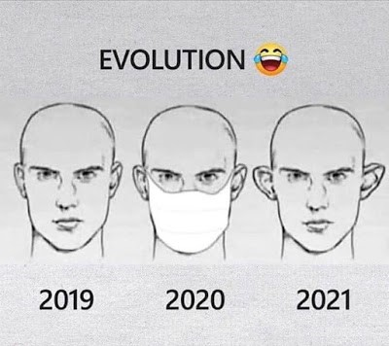

Slide 15
Tyson Packing Plant Holcomb, Kansas

Slide 16
Tyson and Market Influences
YOU couldn’t get 12 Boy Scouts, two boxes of matches, and a gallon of gas to catch that cement and steel structure on fire!
How did the fire only in one plant result in prices dramatically dropping in all other plants?
Where is the full investigation report as to how it happened?
Talk about “market manipulation and control”. Every other packer followed because they could!

Slide 17
UPDATE STATUS USDA Livestock Price Reporting
2016-2018 Reauthorization meetings
2020 Reauthorization will be up this fall?
Sen. Grassley and Tester 50-14 Rule:
Grassley bill would mandate 50 percent cash trade, 14 day delivery for fed cattle
WHO supports 100%? And no packer ownership or control?
Colorado has been a non reporting state in the 5 state report!!!

Slide 18
3-70-20 LPR RULE
Confidentiality Guidelines for the Livestock Mandatory
Reporting Program
The 3/70/20 confidentiality guideline requires the following three conditions:
• At least three reporting entities need to provide data at least 50 percent of the
time over the most recent 60‐day time period.
• No single reporting entity may provide more than 70 percent of the data for a
report over the most recent 60‐day time period.
• No single reporting entity may be the sole reporting entity for an individual
report more than 20 percent of the time over the most recent 60‐day time
period.
The Livestock Mandatory Reporting Act of 1999 requires USDA to publish mandatory
data on livestock and meat price trends, contracting arrangements, and supply and
demand conditions in a manner that protects the identity of reporting entities and
preserves the confidentiality of proprietary transactions.

Slide 19
“FMD TO THE MAINLAND”
The U.S. Department of Agriculture’s (USDA) Animal and Plant Health Inspection Service (APHIS) is seeking public comment on a petition from a vaccine manufacturer seeking approval to produce foot-and-mouth disease (FMD) vaccine consisting of a modified non-infectious and non-transmissible strain of the virus on the U.S. mainland.
Access to FMD vaccine is an important part of our FMD preparedness efforts, but to protect against the introduction of this devastating livestock disease, the live virus of FMD is not allowed anywhere in the country except for the Plum Island Animal Disease Center where it is held and worked with under very strict biocontainment procedures. That exemption will also apply to its successor facility, the National Bio and Agro-Defense Facility, after the facility is complete).
The vaccine, which was developed jointly with USDA’s Agricultural Research Service, is non-infectious, non-transmissible, and incapable of causing the disease because it has been modified in such a way that it is no longer able to produce infection. The manufacturer asserts that because the FMD virus is no longer able to produce infection, it should not be considered live virus of FMD and should be able to be produced on the U.S. mainland.
As part of the petition review process, APHIS is seeking comments from the public on two topics: the manufacturer’s interpretation of live virus and whether there is support for manufacturing the vaccine in the United States. Public comments will be accepted through September 14, 2020 at the following site: https://www.federalregister.gov/d/2020-15031. APHIS will thoroughly review all comments before making its determination.
FMD is a severe and highly contagious viral disease affecting cows, pigs, sheep, goats, deer, and other animals with divided hooves. It was eradicated from the United States in 1929, but if it were to infect the U.S. livestock industry, it would cause devastating economic effect.

Slide 20
MCOOL is the LARGEST MARKETING TOOL and OPPORTUNITY WE’VE HAD! “YOUR EITHER WITH US OR AGAINST US” THANK YOU FOR COMING AND WE APPRECIATE EVERYONE’S CONTINUED INVOLVEMENT AND SUPPORT! R-CALF USA-COOL Committee Chairman Mike Schultz Email: mdaw@st-tel.net Ph. 785-462-1447 mo. “GREAT SPIRITS HAVE ALWAYS ENCOUNTERED VIOLENT OPPOSITION FROM MEDIOCRE MINDS” Albert Einstein

